Slide 1
Generating Realistic Handwritten Digit Images using DCGAN

Slide 2
DCGAN, also known as "Deep Creativity GAN," is like an artist with a wild imagination and an art critic that thinks it knows it all. The "Deep Convolutional" part refers to their superpower of seeing every detail, just like an art critic scrutinizes a painting. Meanwhile, the "Generative Adversarial Network" part is like the epic battle between the artist and the critic.
The artist (the generator) tries its best to create mind-blowing masterpieces, while the art critic (the discriminator) puts on its finest attempts to sniff out any fakeness. It's like a never-ending art show, where the artist is constantly improving and the critic is ever-hungry for more realism.
But here's the funny twist: Sometimes, the artist gets really sneaky and manages to paint such realistic fakes that the critic gets completely fooled! The critic scratches its head and wonders, "Is this a real Van Gogh or just some AI trickery?"
So, DCGAN is like the ultimate art battle, where creativity and critique collide, leading to mind-bending creations and hilarious moments of mistaken identity in the world of artificial artistic genius.

Slide 3
But Wait, What is actually DCGAN??
DCGAN stands for "Deep Convolutional Generative Adversarial Network." It is a type of artificial intelligence model used in the field of machine learning and computer vision. DCGANs consist of two neural networks: a generator and a discriminator.
Generator: The generator network generates synthetic data (e.g., images) from random noise and learns to create realistic data that resembles the training data it was provided.
Discriminator: The discriminator network acts as a classifier that tries to distinguish between real data (e.g., actual images) and fake data produced by the generator.

Slide 4
Want to see the applications of GANs?
Generate Examples for Image Datasets
Generate Photographs of Human Faces
Generate Realistic Photographs
Generate Cartoon Characters
Image-to-Image Translation
Text-to-Image Translation
Semantic-Image-to-Photo Translation
Face Frontal View Generation
Generate New Human Poses
Photos to Emojis
Photograph Editing
Face Aging
Photo Blending
Super Resolution
Photo Inpainting
Clothing Translation
Video Prediction
3D Object Generation

Slide 5
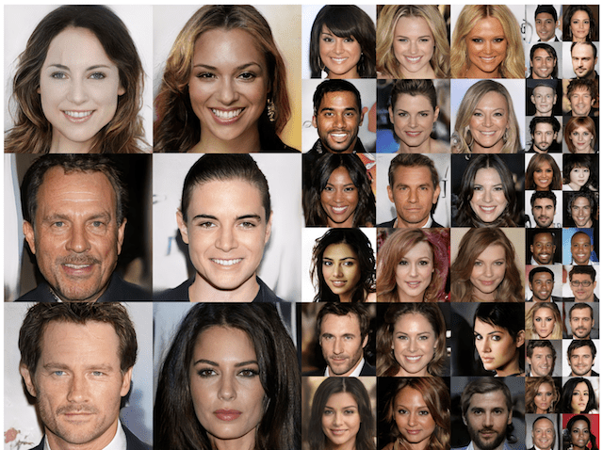
Tero Karras, et al. in their 2017 paper titled “Progressive Growing of GANs for Improved Quality, Stability, and Variation” demonstrate the generation of plausible realistic photographs of human faces.
They are so real looking, in fact, that it is fair to call the result remarkable.
The face generations were trained on celebrity examples, meaning that there are elements of existing celebrities in the generated faces, making them seem familiar, but not quite.
Image Credits : https://machinelearningmastery.com/impressive-applications-of-generative-adversarial-networks

Slide 6
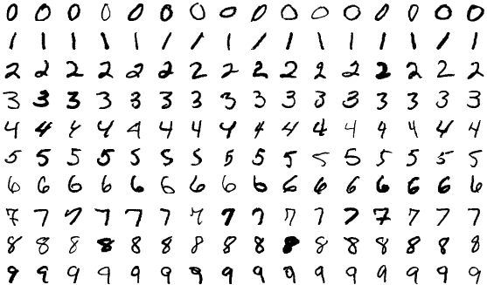
Project Intro
My project aims at generating realistic handwritten digit images with the Deep Convolutional Generative Adversarial Network (DCGAN) using the MNIST dataset. The project involved designing and training both the Generator and Discriminator models using PyTorch deep learning framework.

Slide 7
Hardware and Software Requirements
Software Requirements
Python 3.10.2 (minimum 3.7+).
Google Colab
Deep Learning Framework PyTorch version 2.0.1+cu118(CUDA supported).
NVIDIA GPU T4 from google colab.
Matplotlib version 3.7.2 (minimum 3.5+) for Data Visualization
MNIST Dataset
Hardware Requirements:
Memory (RAM) : (minimum 8GB, recommended 16GB)
Storage: (minimum 1 GB)

Slide 8
WHY PYTORCH??
PyTorch is an open-source deep learning framework that provides a seamless experience for building and training neural networks.
The CUDA support is where the real magic happens! PyTorch with CUDA enables high-speed computations on NVIDIA GPUs, accelerating DCGAN training and generation processes. The parallel processing capabilities of CUDA significantly boost the performance of DCGAN, making it faster and more efficient in creating realistic and artistic images.
It offers an ideal playground for DCGAN experimentation and imaginative creations.

Slide 9
PROJECT METHODOLOGY

Slide 10
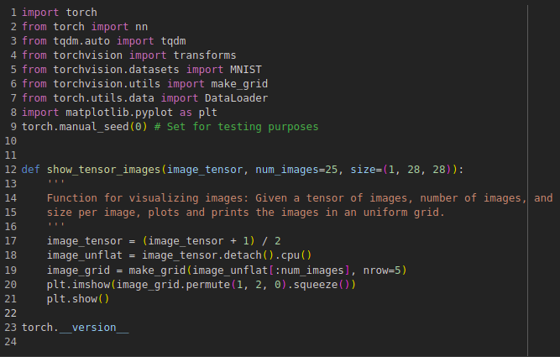

Importing libraries and showing images
Importing Libraries: The code starts by importing necessary libraries, including torch, nn (torch.nn), tqdm, transforms (from torchvision), MNIST (from torchvision.datasets), make_grid, DataLoader, and plt (matplotlib.pyplot).
Setting Seed: The random seed is set using torch.manual_seed(0). This ensures reproducibility of results during testing.
show_tensor_images Function: This function is used to visualize a tensor of images.

Slide 11
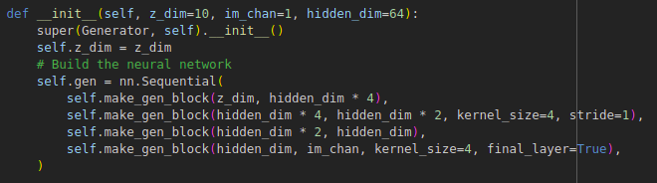
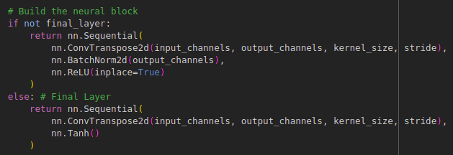
Defining the DCGAN Generator
Generator Class:
Inherits from nn.Module.
Parameters : z_dim (default: 10), im_chan (default: 1 for black-and-white images), hidden_dim (default: 64).
Generator Architecture:
Uses nn.Sequential for sequential layers.
Contains blocks of transposed convolutions, batch normalization, and ReLU activations.
Final layer uses a Tanh activation function.
get_noise function generates random noise vectors of shape (n_samples, z_dim) for training the generator.

Slide 12
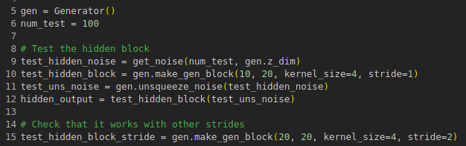
Testing the working of Generator Block
Initialize the Generator (gen).
Generate random noise for testing (test_hidden_noise, test_final_noise, test_gen_noise).
Test the hidden block, the final block and finally the entire generator.
The test results are not included in this response as the code is intended to verify the correctness of the make_gen_block() function by checking if it works with different configurations.
The test ensures the generator block creates the expected output and functions correctly within the DCGAN architecture.
If all the assertions pass without raising any errors, the unit tests will print "Success!" indicating that the make_gen_block() function is working correctly.

Slide 13
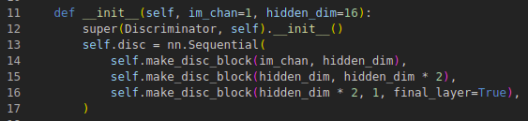
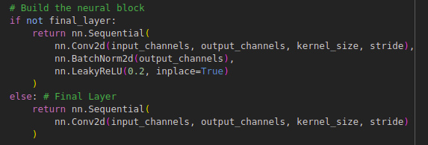
Defining the DCGAN Discriminator
Discriminator Class:
Inherits from nn.Module.
Parameters : im_chan(default: 1 for black-and-white images), hidden_dim (default: 16).
Discriminator Architecture:
Uses nn.Sequential for sequential layers.
Contains blocks of convolutions, batch normalization, and LeakyReLU activations.
make_disc_block: Returns a sequence of operations for a discriminator block in DCGAN.
forward: Performs a forward pass to classify images as real or fake.
The provided code creates the backbone of the discriminator model, ready to be trained with the generator in a DCGAN setup to distinguish real and fake images effectively.

Slide 14
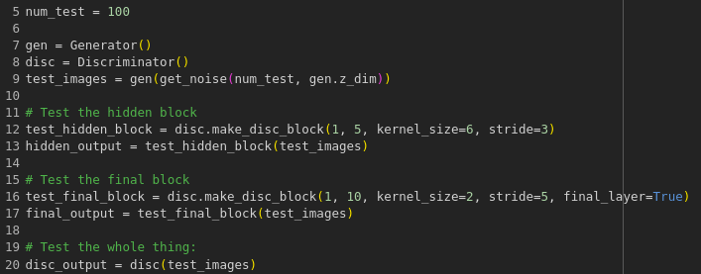
Testing the working of Discriminator Block
Initialize the Generator and Discriminator (gen, disc).
Generate random noise and use the Generator to create test images (test_images).
Testing the hidden block, the final block and the entire discriminator.
The test results are not included in this response as the code is intended to verify the correctness of the make_disc_block() function by checking if it creates the expected output for different configurations.
The tests ensure the discriminator block operates correctly within the DCGAN architecture for classification.
If all the assertions pass without raising any errors, the unit tests will print "Success!".

Slide 15
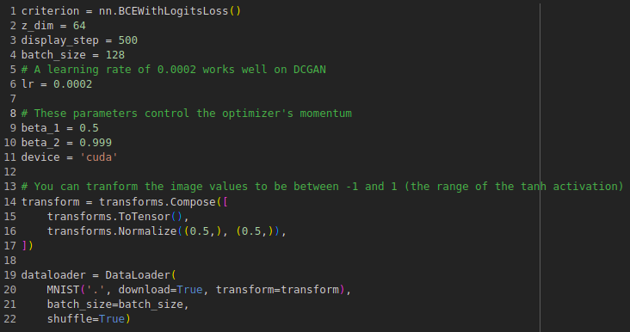
DCGAN Training Parameters and Data Setup
Parameters:
criterion: The loss criterion nn.BCEWithLogitsLoss() is used, which combines a Sigmoid activation and binary cross-entropy loss.
z_dim(default: 64), display_step(default: 500), batch_size(default: 128), lr (default: 0.0002), beta_1 (default: 0.5), beta_2(default: 0.999), device('cuda' if available, otherwise 'cpu').
Data Setup:
transform: A composition of transformations applied to the images. It converts the image values to be between -1 and 1.
dataloader: Creates a DataLoader for the MNIST datasetand shuffle the data during training.
With these parameters and data setup, the DCGAN model is ready for training using the MNIST dataset.

Slide 16
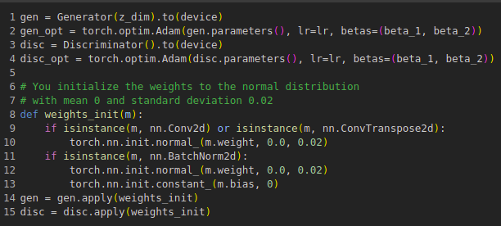
Initializing the Generator and Discriminator for DCGAN Training
Generator Initialization:
The Generator model (gen) is initialized using the Generator class with the given z_dim (dimension of the noise vector) and weights are initialized to the normal distribution.
Discriminator Initialization:
The Discriminator model (disc) is initialized using the Discriminator class and weights are initialized to the normal distribution.
Optimizer Setup:
With these initializations, the Generator and Discriminator models are ready to be trained using the DCGAN architecture on the MNIST dataset.

Slide 17
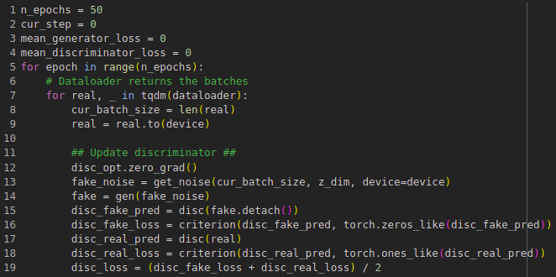
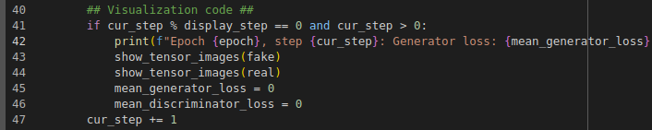
DCGAN Training Loop
Training Loop:
The training loop runs for n_epochs (default: 50) and for each epoch, the dataloader returns batches of real images.
The training loop consists of two steps: updating the Discriminator and updating the Generator.
Updating the Discriminator :
Updating the Generator :
Visualization : After every display_step iterations, the Generator and Discriminator losses are displayed along with visualizations of the fake and real images using the show_tensor_images() function.
This training loop iteratively updates the Generator and Discriminator parameters based on the generated fake images and real images from the dataset.

Slide 18
RESULTS

Slide 19
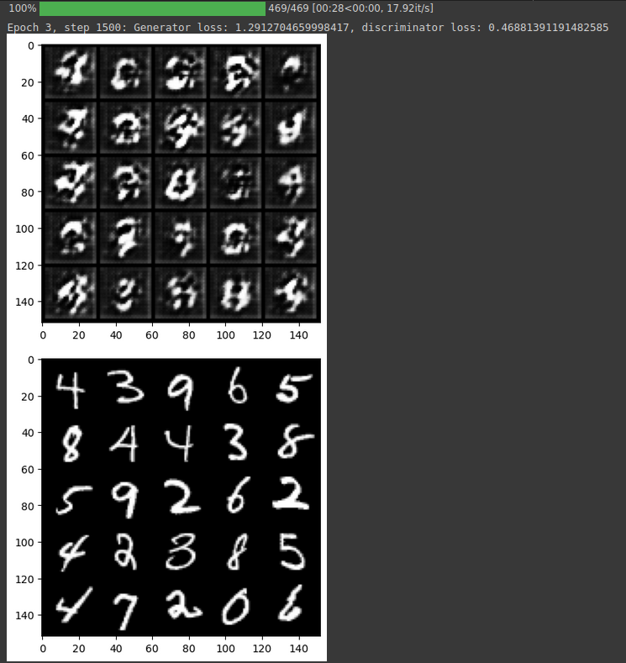
In this project, we successfully implemented a Deep Convolutional Generative Adversarial Network (DCGAN) to generate realistic images.
The total time took by the model to train properly and yield some fascinating result was approximately 2 hrs.
The generated images exhibited increasing quality and realism as the training progressed with subsequent steps of 500. The DCGAN's performance was evaluated based on metrics such as image quality scores, losses, stability, and diversity of generated images.
The project's findings showcased the effectiveness of DCGANs in generating high-quality synthetic images and their potential applications in various domains.

Slide 20
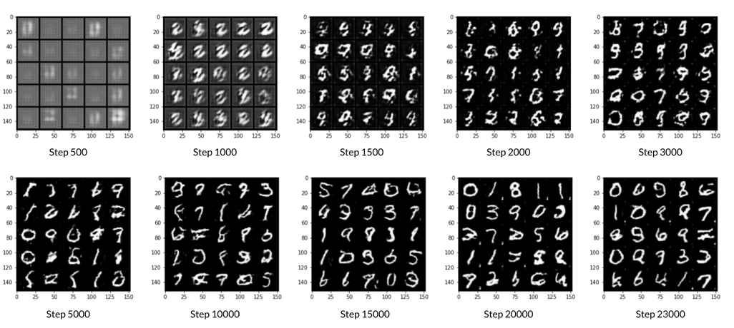
Image Credits : DeepLearning.AI

Slide 21
Generative AI holds the extraordinary power to imagine the unimaginable, creating art, music, and even dreams beyond the boundaries of human imagination. It's the wondrous fusion of creativity and technology, illuminating new realms of possibilities."
- Open.AI

Slide 22
Thanks!

